Slide 1


Data Preprocessing & Exploratory Analysis
This presentation will cover the process of Data Acquisition & Wrangling using Python and Key Libraries including Pandas, NumPy, Matplotlib, Seaborn, and Scikit-learn (SKLearn).
In this project, I used Pandas to organize & explore the data easily. NumPy helped me with math calculations and fixing missing values. I checked the Skewness and Correlation of the data using Seaborn to create visualizations that showed how different variables relate to each other.
To handle missing values & outliers, I used Scikit-learn & its SimpleImputer tool to fill in gaps. I also looked for outliers with charts from Matplotlib and Seaborn.
Overall, this project brought all these tools together to help me analyze the data, check for skewness and correlation, fix missing values, and manage outliers, leading to some really valuable insights!
by Debasis Baidya

Slide 2





Importing of the necessary Libraries
Pandas
To load & organize the datasets, making it easy to explore the data structure and perform operations like merging and filtering.
Numpy
It helped with mathematical operations, allowing me to compute statistics and handle missing values efficiently.
Matplotlib
Used it to create visualizations, such as bar charts and histograms, to better understand the data distributions and trends.
Library 1
Library 2
Library 3
Seaborn
For generating more advanced visualizations, helping me check for skewness & visualize correlations between different variables.
Scikit-learn (Sklearn)
For preprocessing the data, specifically using the SimpleImputer to fill in missing values and to identify and manage outliers effectively.
Library 4
Library 5

Slide 3
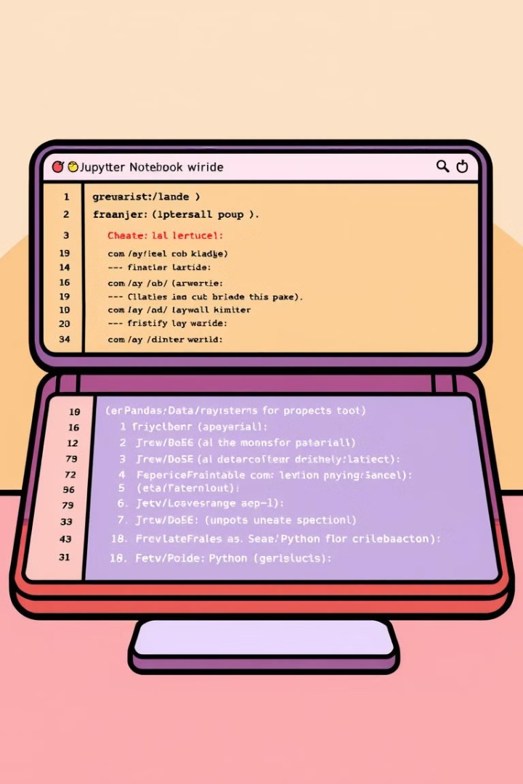
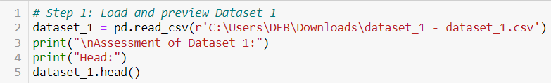
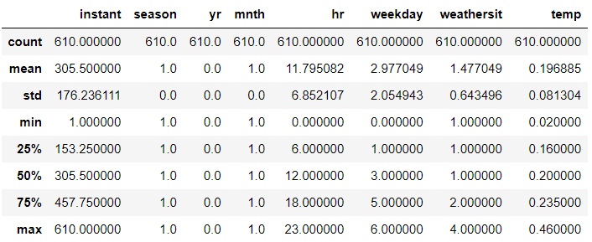
Load and Preview Dataset 1
1
Loaded Dataset 1
Imported the CSV file and displayed the head, tail, shape, column names, and data types.
2
Analyzed Dataset 1
Examined the dataset's structure, including null values and unique value counts.
3
Descriptive Statistics
Compute the mean, median, and mode for the numerical columns in Dataset 1.

Slide 4
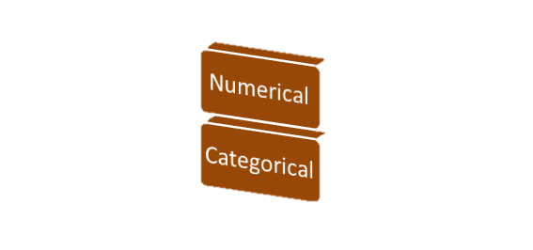

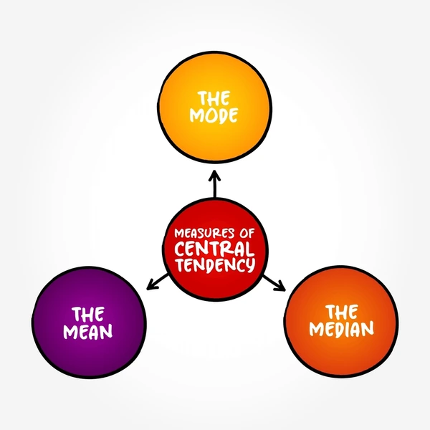
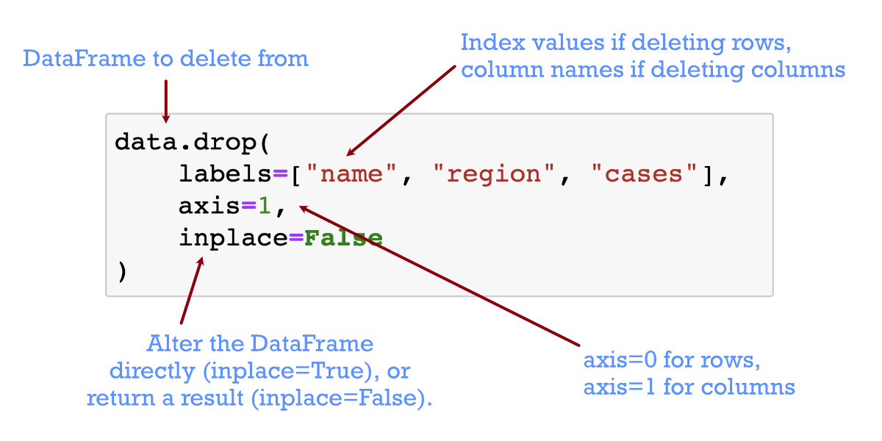
Data Preprocessing for Dataset 1
Identify Data Types
Determined the appropriate data types for each column in Dataset 1
Dropping Columns
Didn’t drop any columns in dataset_1 as all columns appeared important for analysis
Handle Null Values
Imputed numerical columns by importing the SimpleImputer method from sklearn.impute
Central tendency for Dataset 1
Computed the mean, median, and mode for the numerical columns in Dataset 1 from the Pandas Library

Slide 5
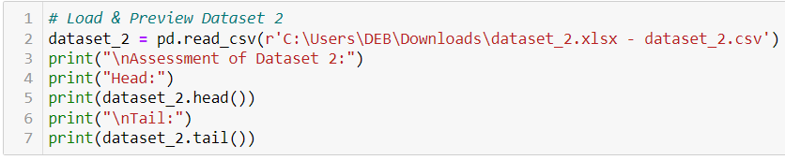
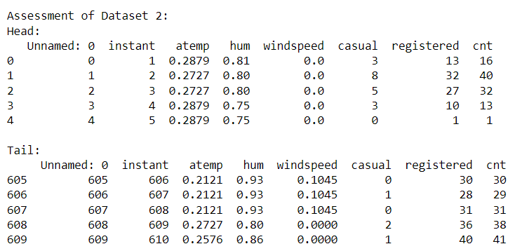
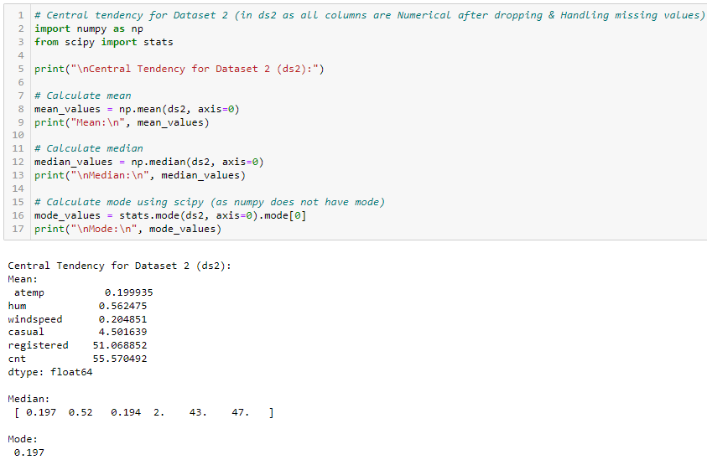
Exploring of Dataset 2
1
Loading and Previewing
Imported the csv file and displayed the head, tail, shape, column names, and data types.
2
Analyzing Dataset 2
Examined the dataset's structure, including null values and unique value counts.
3
Descriptive Statistics
Computed the mean, median, and mode for the numerical columns in Dataset 2.

Slide 6
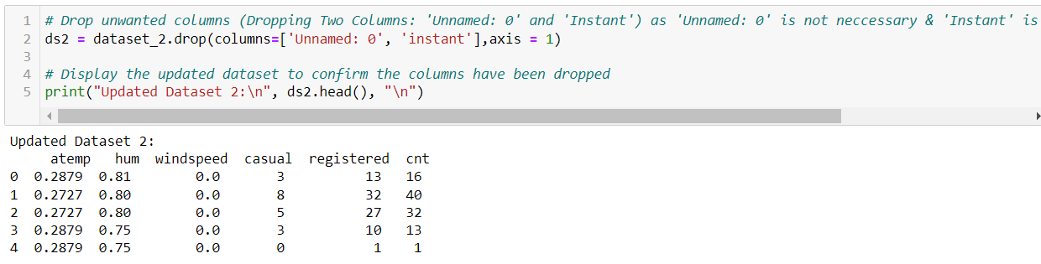
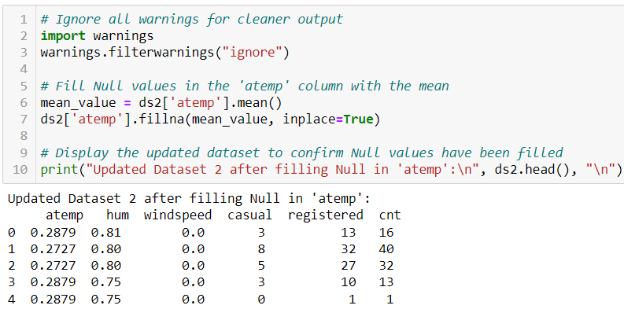
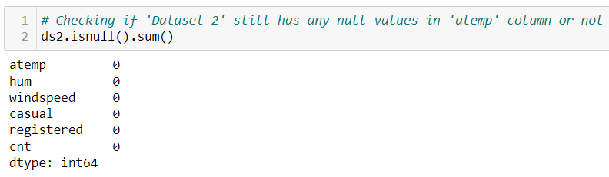
Data Preprocessing for Dataset 2
Dropping Unwanted Columns
Removed the 'Unnamed: 0' and 'instant' columns from Dataset 2.
Handling Missing Values
Filled the 'atemp' column with the mean value.
Central Tendency
Calculated the mean, median, and mode for the numerical columns in Dataset 2.

Slide 7
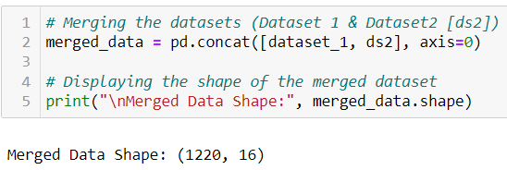
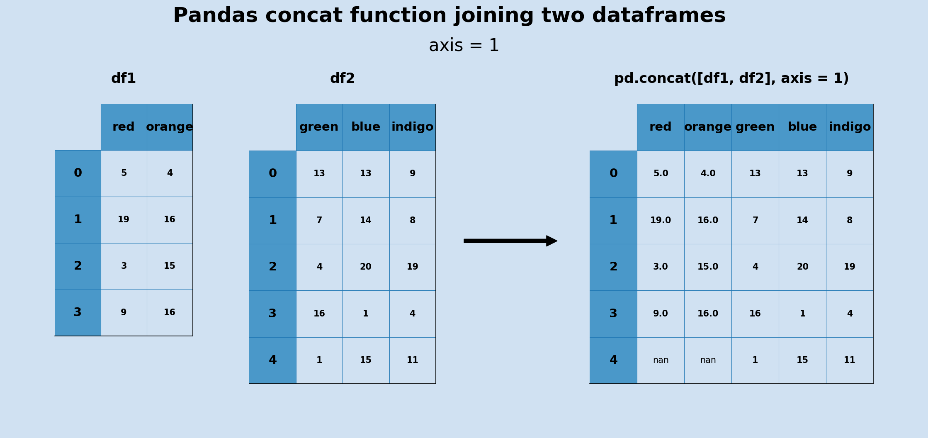
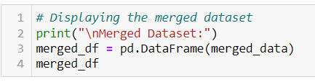
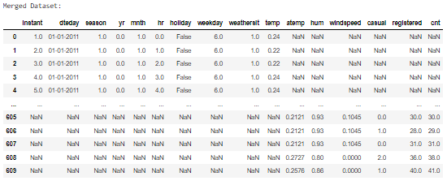
Merging of Dataset 1 & Dataset 2
Combining Datasets
Concatenated Dataset 1 and the cleaned Dataset 2 (ds2) into a single merged dataset. This involves aligning the columns of both datasets based on shared features or key variables. The resulting merged dataset will provide a comprehensive view of the combined data, allowing for further analysis and insights.

Slide 8
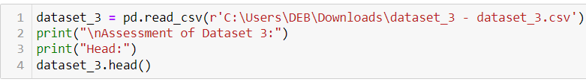
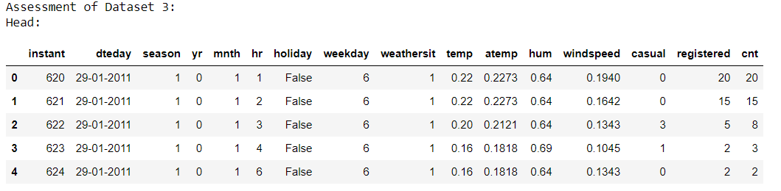

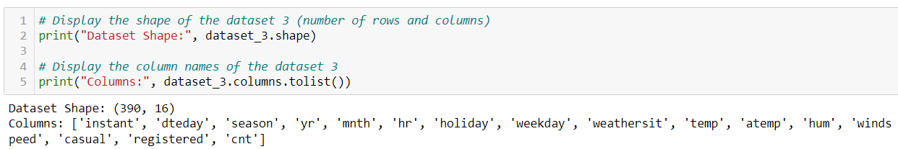
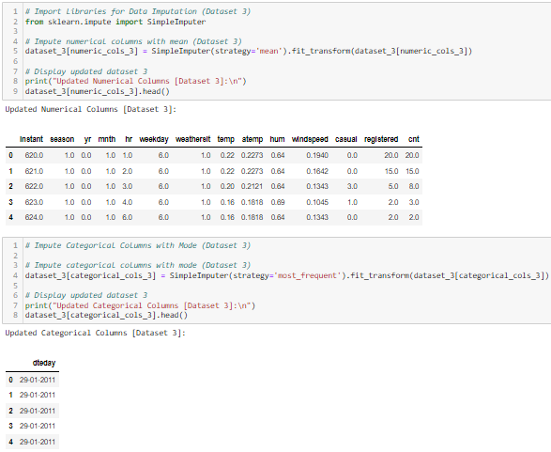


Load and Preview Dataset 3
Loading Dataset 3
Imported the CSV file and displayed the head, tail, shape, and data types, describe.
Analyzing Dataset 3
Examined the dataset's structure and identified any missing values.
Prepared for Merging
Cleaned and preprocessed Dataset 3 to prepare it for combining with the already merged datasets (Dataset 1 & 2).

Slide 9
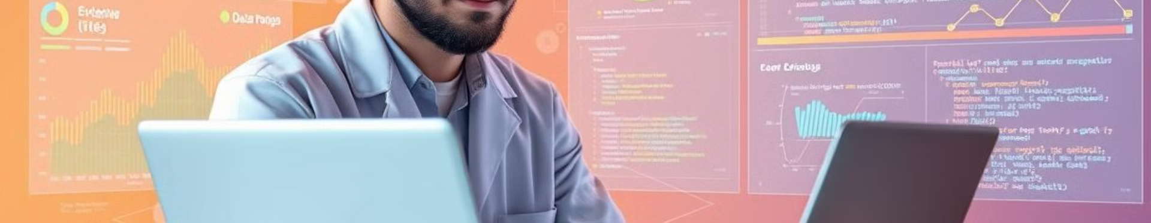



Data Preprocessing for Dataset 3
Imputing Numerical Columns
Imputing Categorical Columns
Central Tendency
Computed the mean, median, and mode for the numerical columns in Dataset 3.
Filled missing values in numerical columns with the mean.
Filled missing values in categorical columns with the mode.

Slide 10

Combining Cleaned Datasets
Dataset 1
Dataset 2
Dataset 3
Cleaned and preprocessed
Cleaned and preprocessed
Cleaned & preprocessed
Ready to be merged with Dataset 2
Merged Dataset 1 with Dataset 2
Merged All to make Final Dataset

Slide 11

Handling Missing Values and Outliers
Missing Value Imputation
Filled missing values in numerical columns with the mean and categorical columns with the mode.
Skewness Analysis
Assessed the skewness of the numerical columns in the final dataset.
01
03
Outlier Detection
Identified and handled outliers in the numerical columns using the interquartile range (IQR) method.
Correlation Visualization
Generated a correlation matrix to explore relationships between the variables.
02
04

Slide 12


I hope you found this presentation helpful and informative. Please don't hesitate to contact me with any questions or feedback you may have. I am more than eager to hear your thoughts and suggestions.
Summary
Future Enhancements
Q&A
I have explored the key aspects of data preprocessing and exploratory analysis, covering steps like data loading, cleaning, merging, and handling missing values and outliers. This analysis provides a solid foundation for further data exploration and model building.
I am open to exploring additional enhancements in the future, including model selection and training. If you have any specific areas you'd like me to delve into or explore further, please let me know.
I am available to answer any questions you may have. Feel free to reach out to me for any questions or clarifications.

